Slide 1
Introduction to Arabic Alphabets Lecture No. 2
Prepared by: Miss Saboor Fatima
Senior Lecturer
Bahria University, Karachi Campus

Slide 2
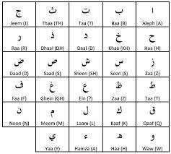

Slide 3


Slide 4
29 Letters are in Arabic Alphabets
RULES OF READING AND WRITING:
Arabic is written and read from right to left
Arabic letters change shape, depending on their placement in a word
Arabic letters are made up of a series of strokes and written in a cursive style

Slide 5
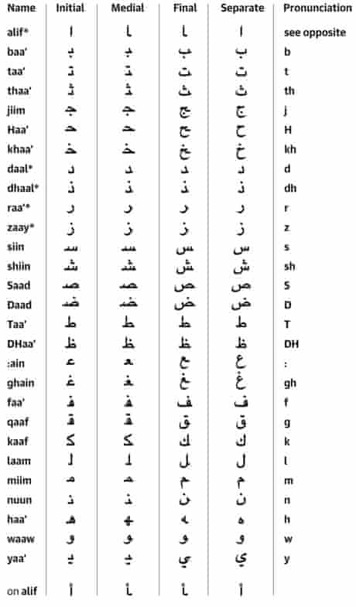

Slide 6
Details:
14 letters are without DOTS (NUKTA)
ا، ح، د، ر، س، ص، ط، ع، ک، ل، م، و، ہ، ء

Slide 7
Details
15 letters are with DOTS (NUKTA)
ب، ت، ث، ج، خ، ذ، ز، ش، ض، ظ، غ، ف، ق، ن، ی

Slide 8
Details:
07 letters are always pronounced BOLD
خ، ص، ض، ط، ظ، غ، ق

Slide 9
Details
03 letters have WHISTLES sound.
ز، س، ص

Slide 10
Similar sound letters
ت ط
ث س ص
ح ہ
ذ ز ض ظ
ع ء
ق ک

Slide 11
Avoid to do AMALA
رب العالمین is correct
ربے العالمین is incorrect

Slide 12
